Slide 1
Network intrusion detection
CAPSTONE PROJECT
Presented By:
Shruti Subramanian – SIES graduate school of technology – AI&DS

Slide 2
Problem Statement
With the rise in cyber-attacks, traditional rule-based intrusion detection systems often fail to detect complex or evolving threats. This project aims to develop a machine learning-based Network Intrusion Detection System (NIDS) that can accurately classify network traffic as normal or malicious, and identify the type of attack. By training on labeled network traffic data, the system enhances detection speed, accuracy, and adaptability. The solution is deployed using IBM Cloud Lite and Watsonx.ai for easy integration and real-time analysis.

Slide 3
Proposed Solution
To address the challenge of detecting various network intrusions effectively, this project proposes a machine learning-based classification system that can analyze network traffic data and predict whether a connection is normal or an attack (e.g., DoS, Probe, R2L, U2R).
Data Collection:
Acquired a labelled network intrusion dataset from Kaggle containing various types of network traffic and cyber-attacks.
Data Preprocessing:
Cleaned and encoded the dataset by handling categorical features, removing duplicated, scaling numerical values, and splitting into training and testing sets.
Machine Learning Algorithm:
Applied and trained classification algorithms such as Random Forest, Logistic Regression and XGBoost to detect and classify network intrusions
Deployment:
Deployed the trained model on IBM Watsonx.ai using IBM cloud lite, enabling real-time prediction through a simple user interface.
Evaluation:
Evaluated the model using metrics such as accuracy, precision, recall, F1-score, and confusion matrix to access its effectiveness in detecting cyber threats.
Result: The best-performing model was random forest, achieving an accuracy of 96.3% on the test dataset.
The model was successfully deployed using IBM Watsonx.ai, allowing real-time intrusion prediction through test inputs.

Slide 4
System Approach
System requirements: The system requires a computer with Windows, macOS, OR LINUX OS, at least an Intel i5/Ryzen 5 processor, 8 GB RAM, and a stable internet connection.
Library required to build the model: I used libraries like pandas, numpy, scikit-learn, and XGBoost for data handling and model training, while joblib helps in saving the model. The trained model is deployed and tested using IBM watsonx.ai on IBM cloud, enabling real-time intrusion detection through a user-friendly interface.

Slide 5
Algorithm & Deployment
Algorithm Selection:
The random forest classifier was chosen for its accuracy, resistance to overfitting and effectiveness in handling complex classification problems like intrusion detection.
Data Input:
The model was trained on a labelled intrusion detection dataset containing 41 features representing network traffic behaviour, including protocol type, duration, bytes transferred and more.
Training Process:
The data was pre-processed (encoding, scaling, and splitting) and the random forest model was trained to recognize patterns associated with normal and malicious network activity.
Prediction Process:
Once deployed the model receives new traffic data as input and classifies it as normal or anomaly attack. This prediction returned through the IBM Watsonx.ai interface for real-time analysis.

Slide 6
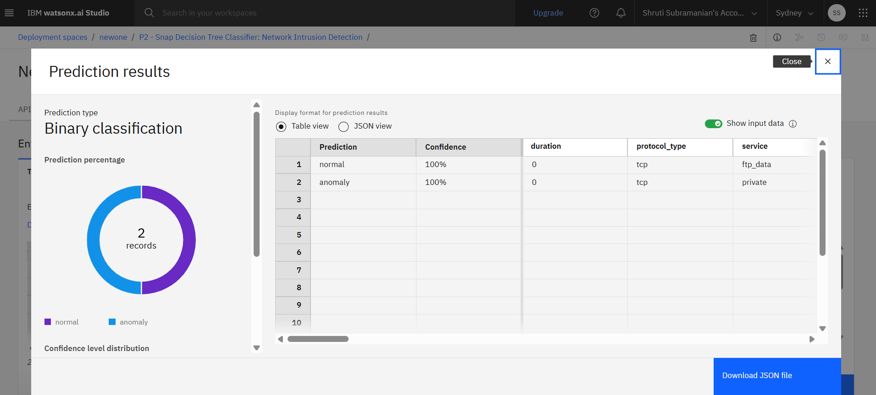
Result

Slide 7
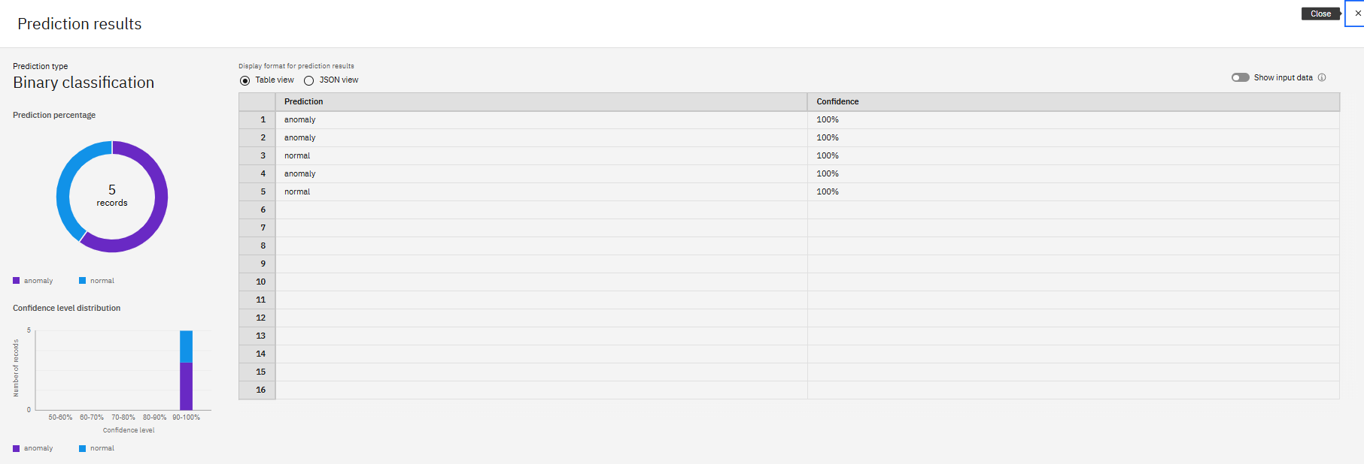

Slide 8
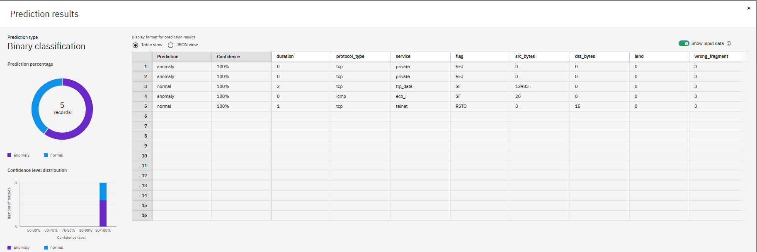

Slide 9
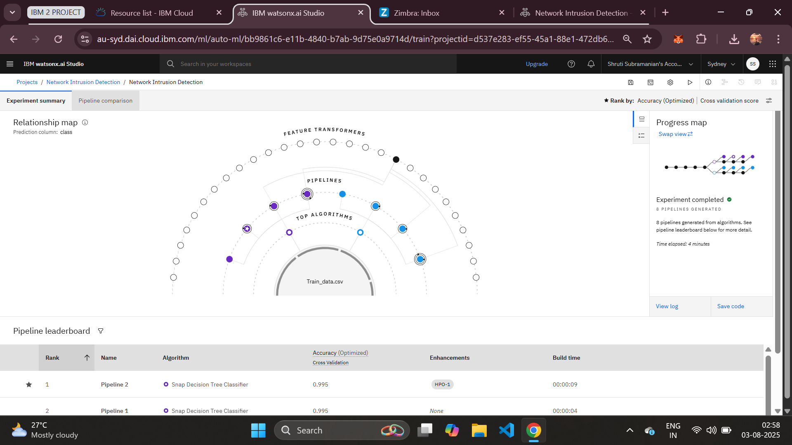

Slide 10
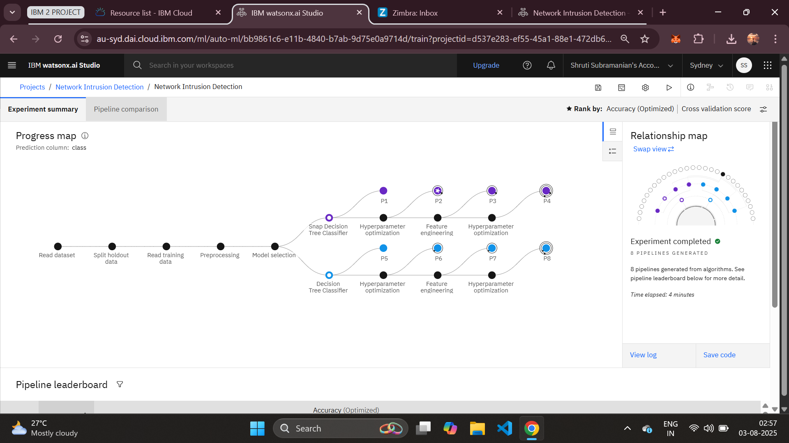

Slide 11
Conclusion
The Network Intrusion Detection System developed using machine learning effectively identifies malicious network activity with high accuracy. By leveraging the Random Forest algorithm, the model achieved strong performance in classifying various types of attacks and normal traffic. The system was successfully deployed using IBM Watsonx.ai, allowing for real-time predictions through a cloud-based interface. This project demonstrates the potential of machine learning in enhancing cybersecurity by enabling faster, more accurate, and automated threat detection. Future improvements may include deep learning models, real-time streaming data, and broader attack coverage.

Slide 12
Future scope
Real-Time Monitoring: Integrate the system with live network traffic for real-time intrusion detection and alerts.
Deep Learning Models: Explore advanced models like LSTM or CNNs for improved detection of complex attack patterns.
Expanded Attack Coverage: Include newer and more sophisticated cyber-attacks beyond the current dataset.
Adaptive Learning: Implement online learning techniques to allow the model to adapt to evolving threats over time.
Dashboard Integration: Build a user-friendly dashboard for security teams to view threats, logs, and system status in real time.
Multiclass Enhancements: Improve the system’s ability to distinguish between multiple types of attacks with greater accuracy.
Cloud API Access: Deploy the system as a secure API for integration into existing security infrastructure.

Slide 13
References
Kaggle Dataset – Network Intrusion Detection https://www.kaggle.com/datasets/sampadab17/network-intrusion-detection
Scikit-learn Documentation https://scikit-learn.org/stable/
XGBoost Documentation https://xgboost.readthedocs.io/
IBM Watsonx.ai – Model Deployment Documentation https://www.ibm.com/docs/en/watsonx

Slide 14
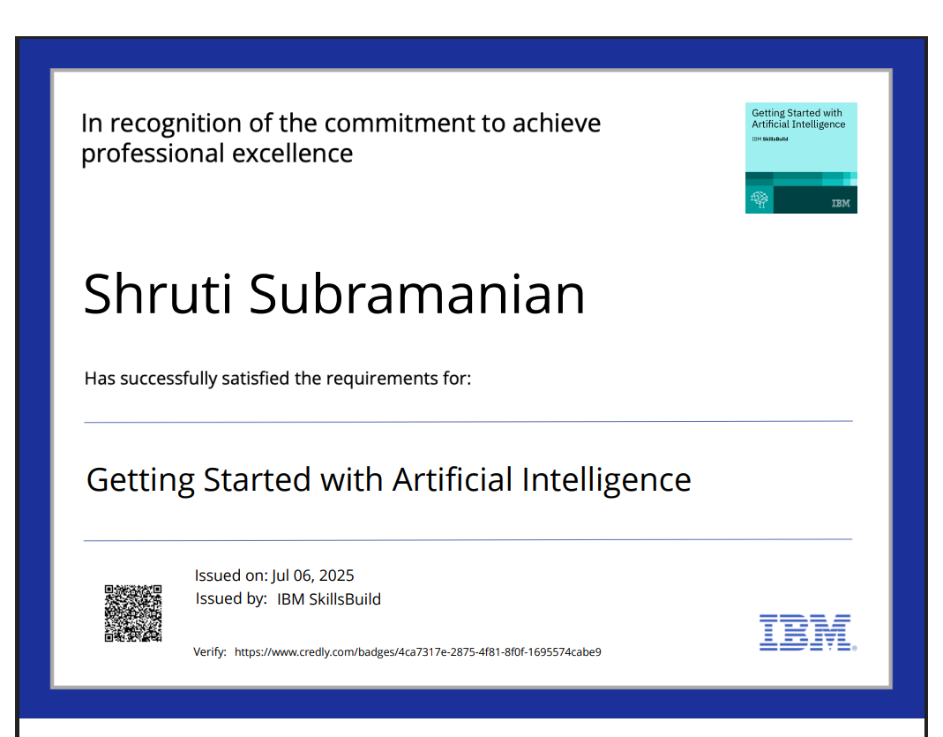
IBM Certifications

Slide 15

IBM Certifications

Slide 16

IBM Certifications

Slide 17
THANK YOU

